Slide 1
Advancing Memory with Brain Implants
SIT CS-B | Design Thinking | Group No. 26
Mohammad Omar
PRN. 21070122095
Sarothi Adhikary
PRN. 21070122148
Sangeet Agrawal
PRN. 21070122140
Saylee Mangalmurti
PRN. 21070122151

Slide 2
Contents
1
2
3
4
5
6
7
Problem Selection
Finalized Problem
Ideation Phase
Proposed Solution
Mind Map
SWOT Analysis
User Feedback

Slide 3
Problem Selection
Problems | Opportunities
Tutorial Platform for Smartphones and Laptops | Rising demand for comprehensive online guidance. Fragmented resources lack centralized accessibility. Opportunity for an integrated, user-centric solution.
Memory Recall through Brain Implants | Increasing prevalence of memory-related challenges. Ineffectiveness of current interventions. Potential for groundbreaking memory enhancement technology.
Paperless Digital Screens inspired by Iron Man | Environmental concerns driving the need for paper alternatives. Persistence of paper-based methods despite technological advancements. Potential for transformative digital solutions.

Slide 4
Finalized Problem
Need to be Addressed
Core Problem Statement
Prevalent memory loss due to aging, stress, trauma, and neurological conditions like Alzheimer's.
Lack of effective interventions to address memory loss and preserve cognitive function.
Impact on the overall well-being and quality of life of affected individuals.
The need for innovative interventions to mitigate memory loss and preserve cognitive function in individuals affected by aging, stress, trauma, and neurological conditions such as Alzheimer's, in order to enhance their overall well-being and quality of life.

Slide 5
Ideation Phase
Contributors | Ideas
Sarothi Adhikary | I think it should always be a part of the human body, like a brain implant
Sangeet Agrawal | But how would the memories be stored? We could consider implementing cloud storage for memories captured by brain implants.
Mohammad Omar | Safety and ease of deployment are crucial. We must consult medical professionals to ensure safe implementation. Also, what if it could be connected to the eye? Like, on double blinking, memories could be accessed.
Saylee Mangalmurti | Absolutely, we need to make sure it's user-friendly for all ages. Instead of connecting it directly to the eyes, maybe we could use something like a spectacle. When worn, it could connect with the brain and then access memories.

Slide 6
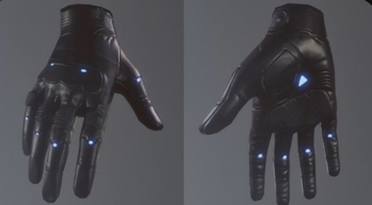
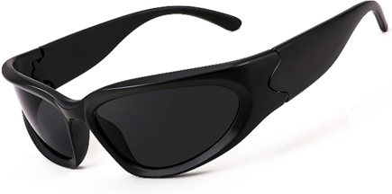
Proposed Solution
Developing a brain implant for memory storage utilizing cloud technologies, enabling access to memories at a later time.
The system would incorporate spectacles to initiate a virtual display and a specialized glove-like structure for interacting with the display.

Slide 7
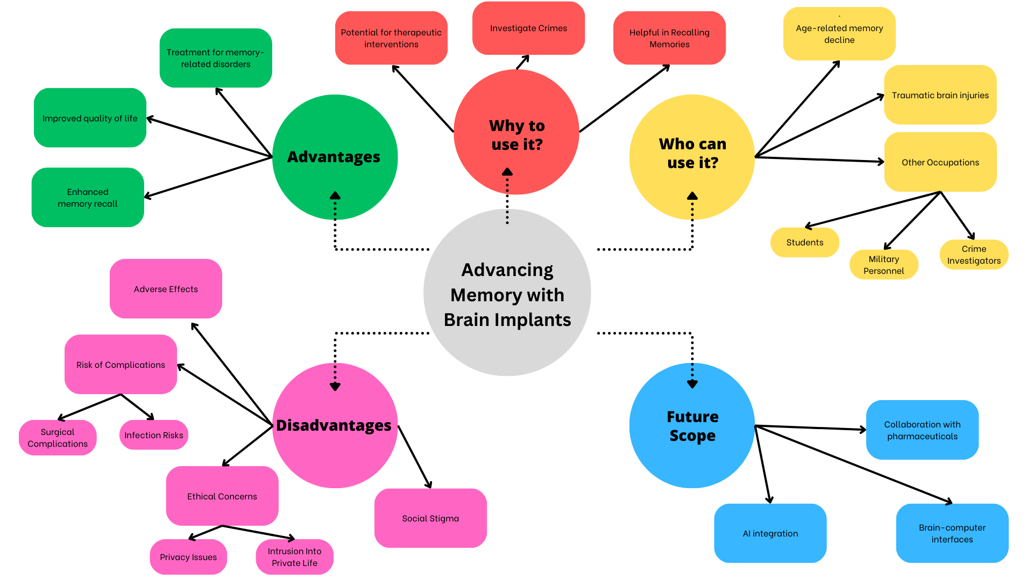

Slide 8
SWOT ANALYSIS
Strength | Weakness | Opportunity | Threats
Effective in enhancing memory recall | Risk of surgical complications and adverse effects | Collaboration with pharmaceutical companies for combined treatments. | Ethical concerns regarding privacy
Potential long-term solution for memory-related disorders. | High cost of surgery and implantation | Integration with artificial intelligence for personalized memory enhancement. | Social stigma associated with brain implants.
Personalized memory enhancement based on individual needs | Limited accessibility to the technology due to cost and availability | Collaboration with academic institutions for research and development | Potential for misuse or abuse of memory enhancement technology

Slide 9
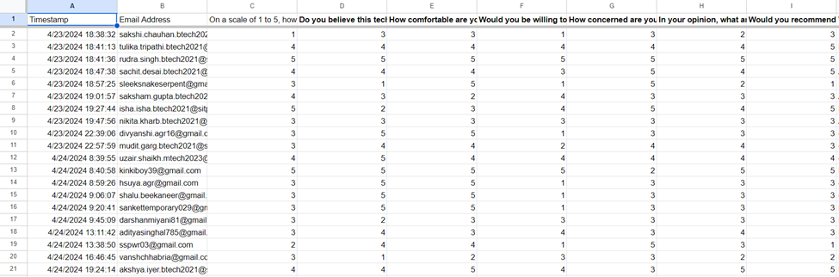
Feedback

Slide 10
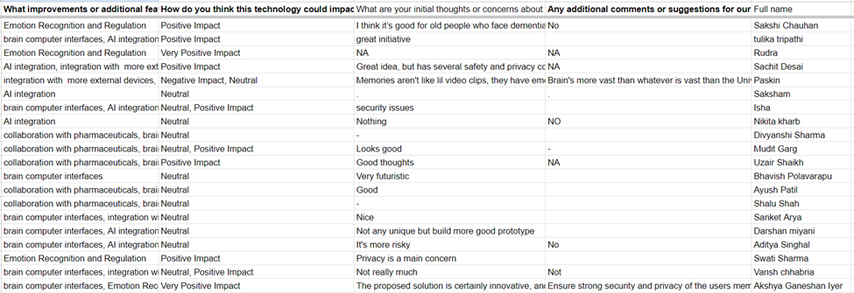
Feedback

Slide 11
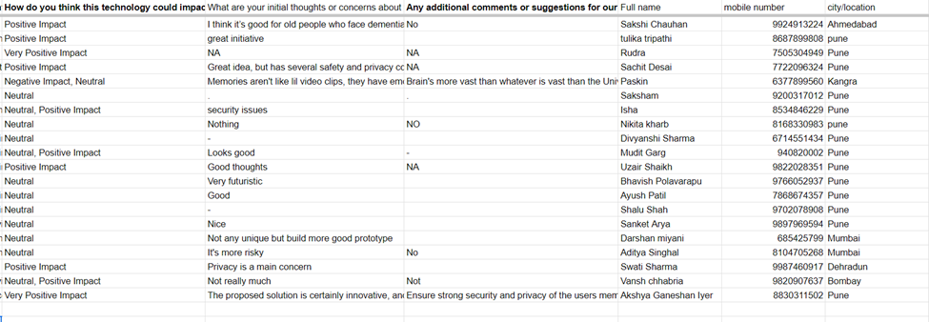
Feedback

Slide 12
Thanks!
SIT CS-B | Design Thinking | Group No. 26
Mohammad Omar
PRN. 21070122095
Sarothi Adhikary
PRN. 21070122148
Sangeet Agrawal
PRN. 21070122140
Saylee Mangalmurti
PRN. 21070122151
Hope you have a nice day ahead! 😃

